Slide 1

Bank Report

Slide 2
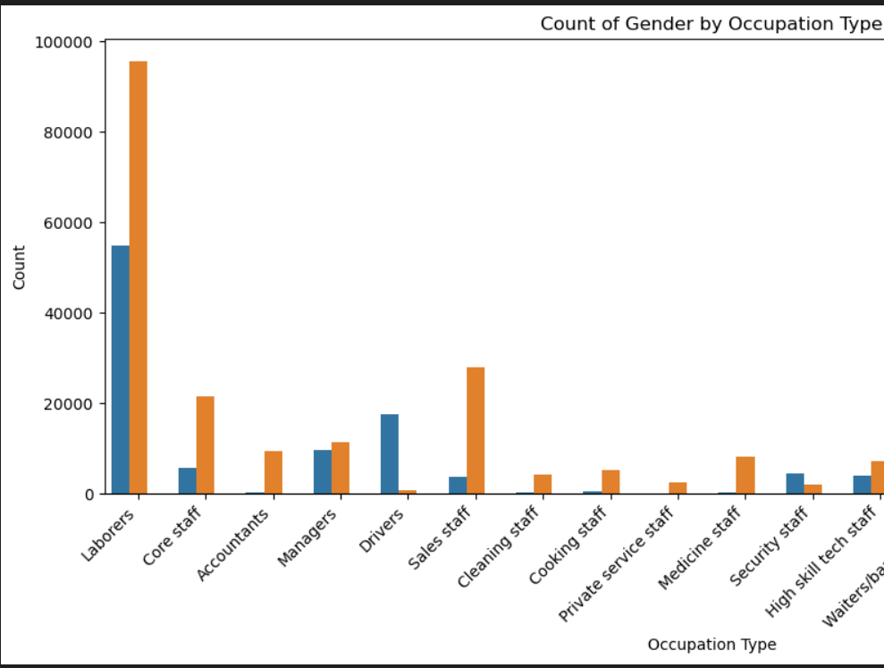
💡 Insights for Loan Decisions
High-volume occupations:
Laborers and core staff have the highest counts, especially among females.
These roles may indicate lower or moderate income levels, so you might assess their creditworthiness more cautiously.
Male-dominated roles:
Drivers and security staff are mostly male. These jobs might have more stable income depending on the sector.
Female-dominated roles:
Accountants, cleaning staff, and sales staff are mostly female. Accountants may be more financially stable, while cleaning and sales roles might vary.
Mixed or low-count roles:
Managers, IT staff, HR staff, and medicine staff show a mix of genders but lower counts. These could represent higher-skilled applicants with better financial profiles

Slide 3

🏦 How You Can Use This
Risk profiling: Use occupation type as one factor in assessing loan risk. For example, applicants in high-skill or stable jobs may be lower risk.
Gender trends: If your bank tracks repayment behavior by gender, this chart helps you understand which occupations are gender-heavy and tailor your strategy.
Targeted marketing: You could design loan products for specific occupations with high representation, like laborers or core staff.

Slide 4
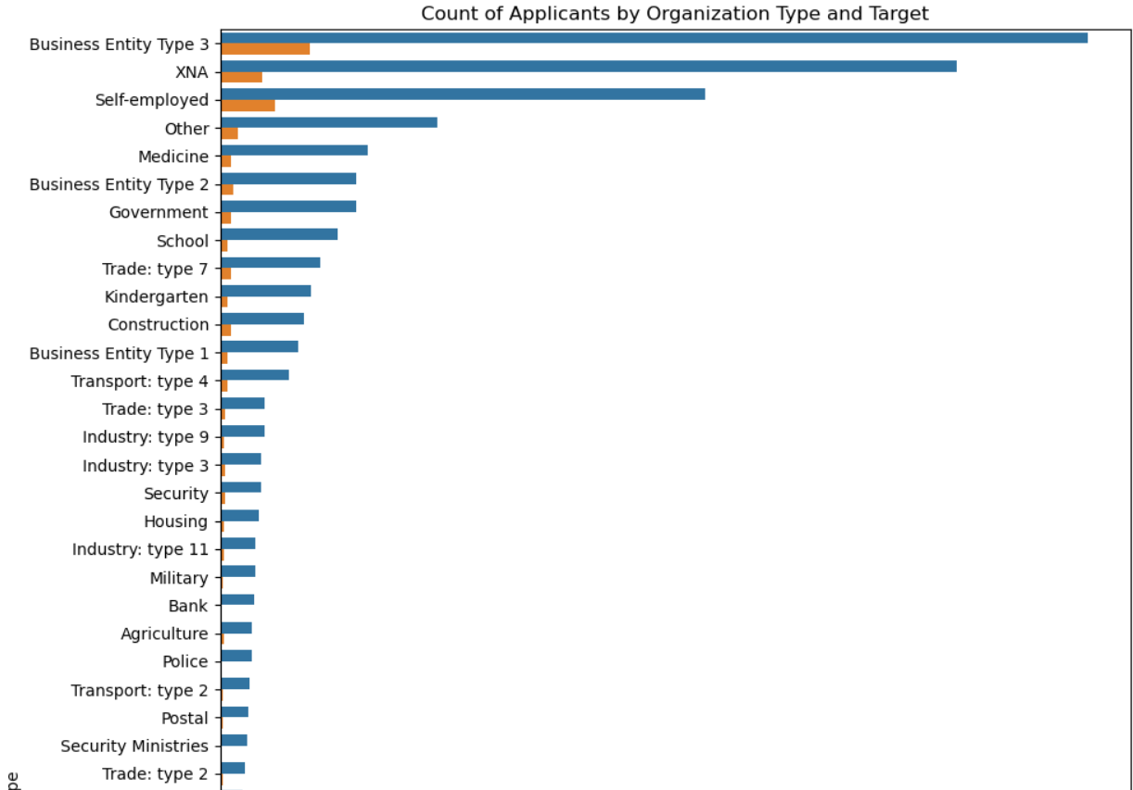
💡 How to Interpret It
High applicant volume:
Business Entity Type 3, Self-employed, and Government have the most applicants.
You can analyze approval rates in these categories to refine your lending strategy.
Approval vs. rejection trends:
If a category has more orange bars than blue, it may indicate higher risk or lower approval rates.
For example, if Self-employed has many applicants but most are rejected, you might want stricter criteria for that group.
Low-volume but high-approval groups:
Some categories like Military, Bank, or Police may have fewer applicants but higher approval rates—potentially more reliable borrowers.

Slide 5

🏦 Strategic Use for Loan Decisions
Risk segmentation: Use this chart to identify which organization types are associated with higher default risk.
Policy refinement: Adjust your loan policies for specific groups. For example, offer tailored products for government employees or tighten rules for self-employed applicants.
Marketing focus: Target high-approval groups with promotional loan offers to boost your portfolio quality.

Slide 6
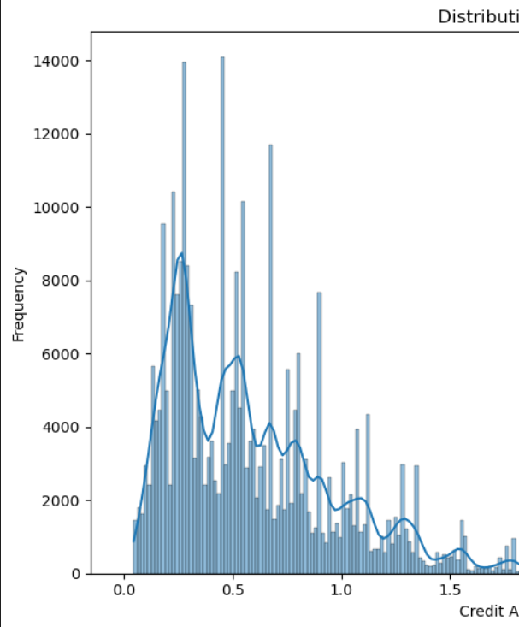
💡 Insights for Loan Strategy
Most common credit amounts:
The peak of the histogram is around the lower end—likely between 0.5 to 1 million. This means most applicants request relatively modest loans.
Long tail:
There are fewer applicants requesting very high amounts (2–4 million), but they do exist. These might be business loans or high-income individuals.
Risk vs. reward:
Smaller loans are more frequent and may carry lower risk.
Larger loans are rarer but could be more profitable—though they require stricter vetting.

Slide 7

🏦 How You Can Use This
Set loan tiers: Create different approval criteria for low, medium, and high credit amounts.
Optimize interest rates: Offer competitive rates for popular loan sizes to attract more customers.
Portfolio balance: Use this distribution to ensure you're not overexposed to high-risk, high-amount loans.

Slide 8
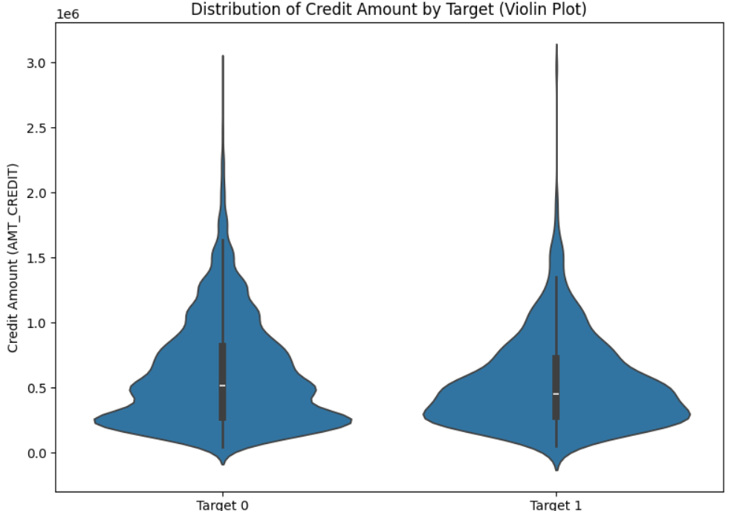
🎻 What the Plot Show
Similar distributions: Both approved and rejected applicants request similar credit amounts overall.
Median comparison:
The median credit amount is slightly higher for Target 0 (approved loans), suggesting that moderate-to-high loan requests are more likely to be approved.
Density differences:
Target 1 (rejected loans) has a slightly wider spread at lower amounts, which might indicate that smaller loans are not automatically safer.
Outliers:
Both categories show applicants requesting very high amounts (close to 3 million), but these are rare.

Slide 9
🏦 How You Can Use This
Refine
Refine approval criteria: Use credit amount as one factor in your decision-making, but don’t assume smaller loans are always safer.
Modeling
Risk modeling: Combine this with income, occupation, and organization type to build a more accurate risk profile.
Loan
Loan product design: Offer tailored products for the most common credit ranges to improve approval rates and customer satisfaction.

Slide 10
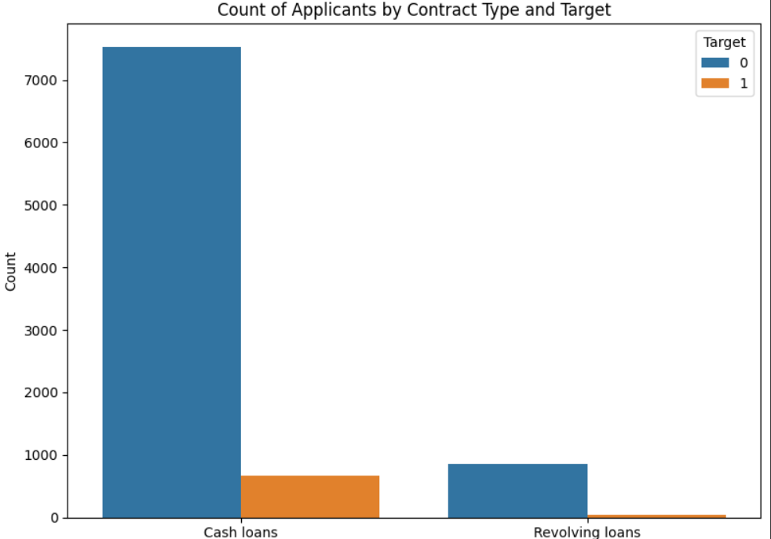
💡Contract type
Cash loans:
Most applicants fall into this category.
Around 7,500 were approved (Target 0), and about 1,000 were rejected (Target 1).
This suggests cash loans are popular and relatively safe, but still carry some risk.
Revolving loans:
Far fewer applicants overall.
Nearly all were approved, with almost zero rejections.
This could indicate that revolving loans are typically given to more creditworthy individuals or have stricter pre-screening.

Slide 11

🏦 Strategic Takea ways
Cash loans:
High volume, moderate risk.
Consider refining approval criteria to reduce rejections while maintaining volume.
Revolving loans:
Low volume, very low risk.
You might want to promote these more if they align with your risk appetite.
Portfolio balance:
Use this data to decide how much of your lending should go toward each contract type.

Slide 12
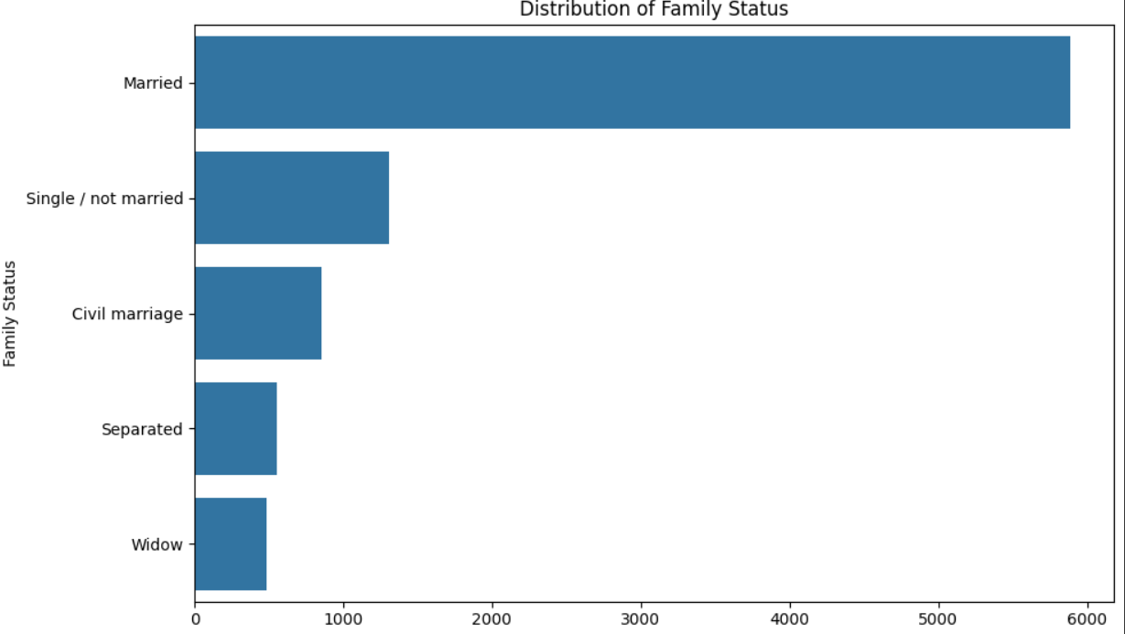
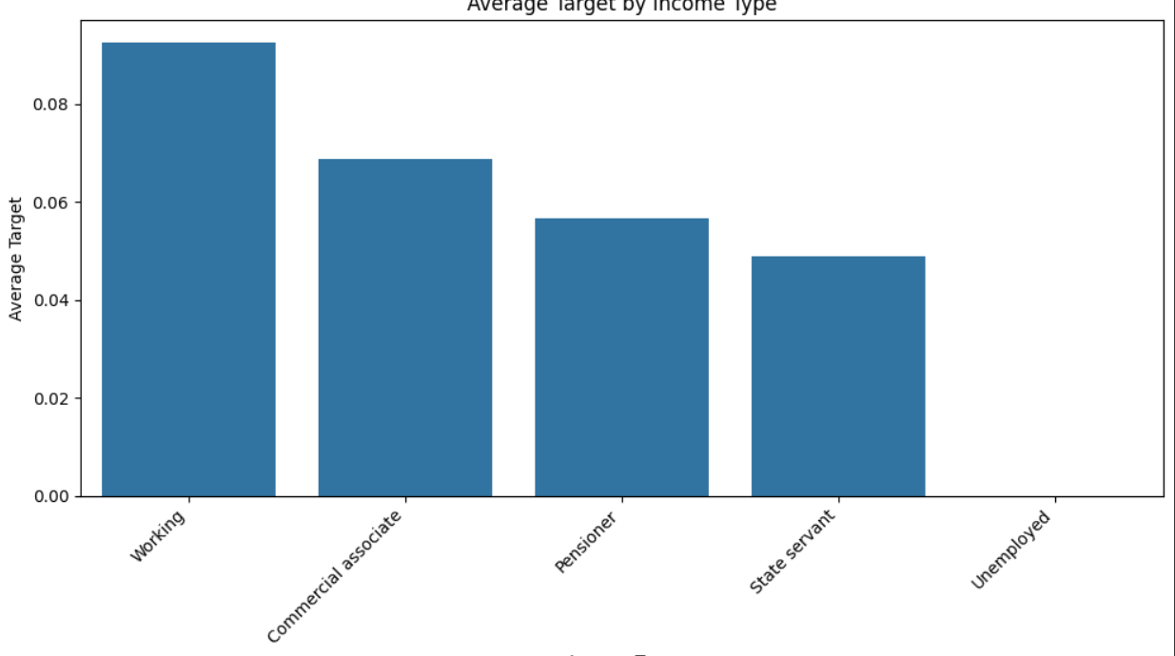
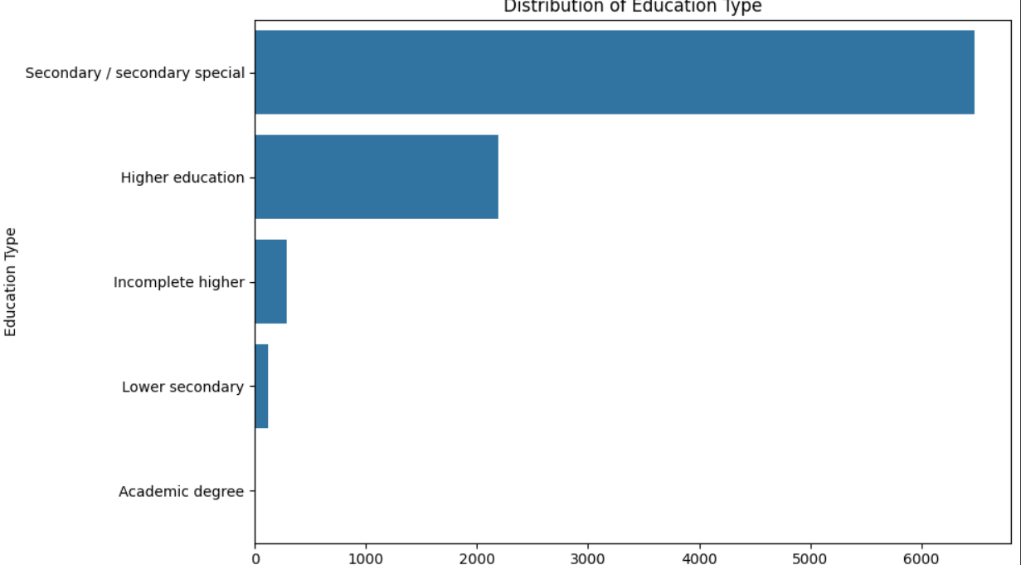
📊 Average Target by Income Type
What it shows: This chart displays the average default rate (TARGET) per income type.
Interpretation (Risk):
Working individuals have the highest average target, meaning they are more likely to default.
Commercial associate, Pensioner, and State servant have lower average targets.
Unemployed shows almost zero, likely due to low sample size (be cautious).
✅ Actionable Insight: You might prefer giving loans to State servants and Pensioners over Working individuals based on historical default behavior

Slide 13
🎓 Distribution of Education Type
What it shows: Number of clients per education level.
Interpretation (Volume):
Most clients have Secondary / secondary special education (by far the majority).
Followed by Higher education.
✅ Actionable Insight: Focus risk modeling and credit strategies around the largest group (secondary), but also consider how education correlates with default rate (not shown here directly, but should be analyzed).

Slide 14

👪 Distribution of Family Status
What it shows: Number of clients by marital status.
Interpretation (Volume):
Majority are Married.
Significant number are Single or in Civil marriage.
✅ Actionable Insight: Married clients dominate your dataset — credit policies and campaigns can be optimized for this group. You could also analyze default rate by family status to see if there's a correlation

Slide 15

🔍 Final Recommendations
To decide who gets a loan, you should:
Combine risk (TARGET) data with demographic attributes.
Prefer income types with lower default rates.
Analyze how education and family status impact risk (next step could be to visualize TARGET averages for these as well).
Use this data to train or improve a credit scoring model

Slide 16

⚙️MODELS WE MADE
these models to predict whether a loan applicant is likely to repay their loan ('Target 0') or default ('Target 1')
Based on the results:
The Random Forest and SVM models have the highest overall accuracy. This means they are good at predicting whether a customer will repay or not.
However, the Decision Tree model has the highest F1 score. This is very important for you as a bank owner because it suggests that while the Decision Tree might have a slightly lower overall accuracy, it's better at identifying the riskiest customers (those likely to default), which is crucial for minimizing losses.
In summary: While Random Forest and SVM are more generally accurate, the Decision Tree model appears to be the most effective at identifying potential loan defaulters based on the F1-score. You might consider using the Decision Tree model or a combination of models to help you make more informed decisions about loan applications and manage your risk.

Slide 17

🧮Strategies for Loan Default Prediction and Risk Management
Investigate high-risk customer segments: Use demographic and occupational data to identify and strategize for riskier groups. Consider offering tailored products or requiring additional documentation for these segments.
Gather more data on key features: Incorporate more relevant data points like external credit history, existing debt obligations, and behavioral data to enhance prediction accuracy.
Monitor and Retrain Models Regularly: Continuously monitor the performance of your chosen model and retrain it with fresh data periodically to ensure its predictions remain accurate and relevant in a changing economic landscape.
Integrate Model Insights with Human Expertise: Use the model's predictions as a powerful tool to support, not replace, the expertise of your loan officers. Their experience can be invaluable in nuanced cases.
Analyze the Costs of Prediction Errors: Understand the financial implications of false positives (denying a good customer) and false negatives (approving a loan that defaults) to optimize the model's decision thresholds based on your risk appetite.
Develop Early Warning Systems: Implement systems that flag loans showing early signs of distress based on payment behavior or changes in customer circumstances.
Personalize Loan Products and Terms: Use the insights from your data to offer personalized loan products, interest rates, or repayment terms that better align with the risk profile of different customer segments.

